Slide 1
HR Data Analysis
Aditya Dube

Slide 2
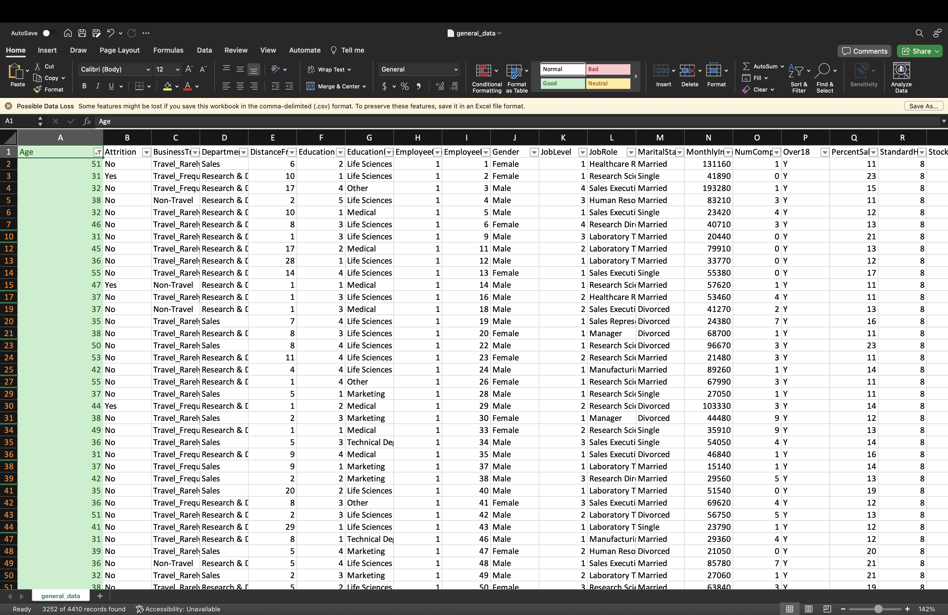
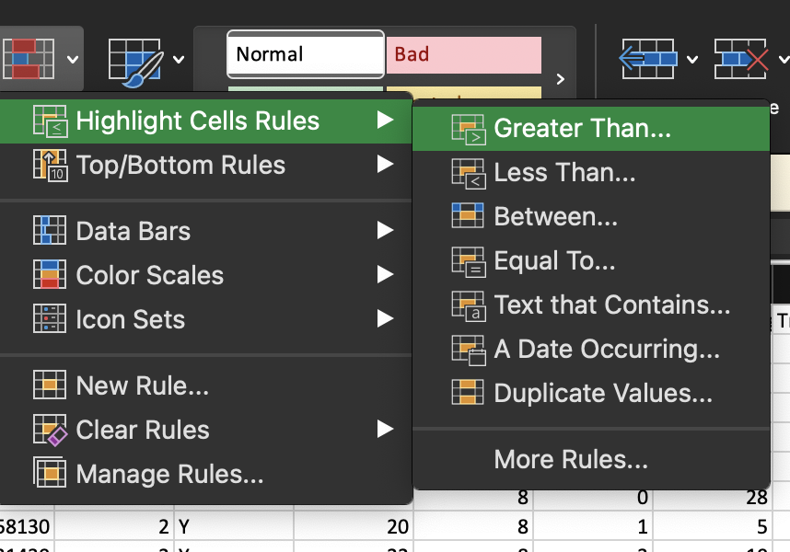
1. Using Excel, how would you filter the dataset to only show employees aged 30 and above?

Slide 3
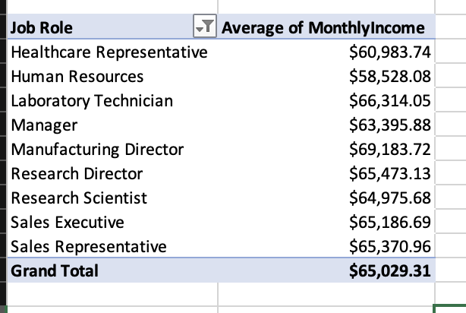
2. Create a pivot table to summarize the average Monthly Income by Job Role.

Slide 4
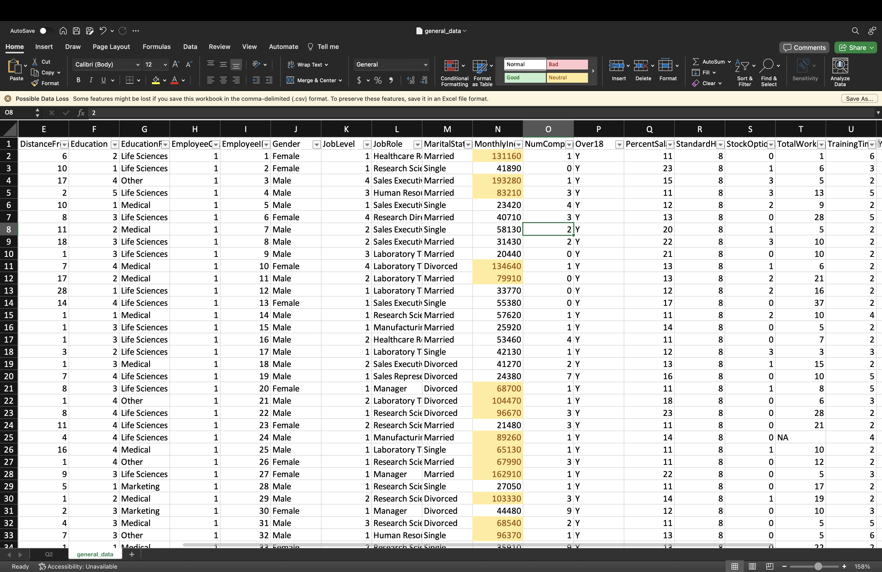
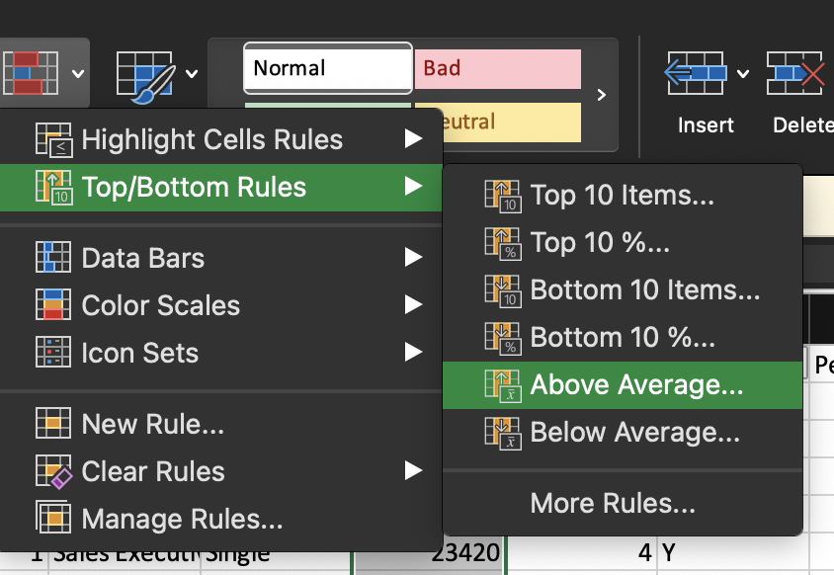
3. Apply conditional formatting to highlight employees with Monthly Income above the company's average income.

Slide 5
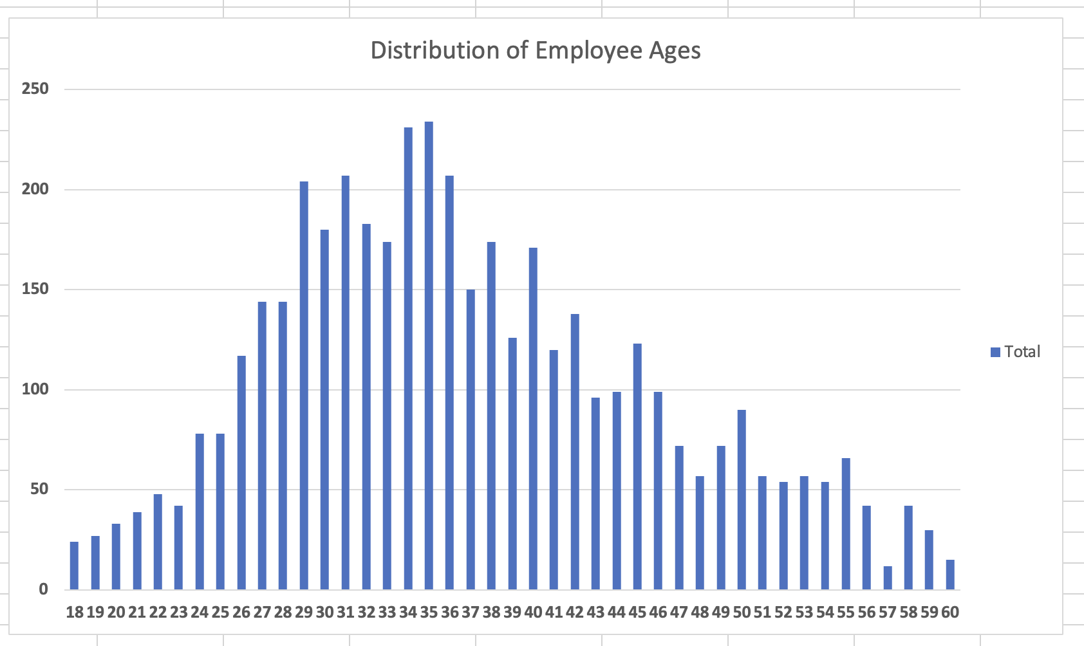
4. Create a bar chart in Excel to visualize the distribution of employee ages.

Slide 6
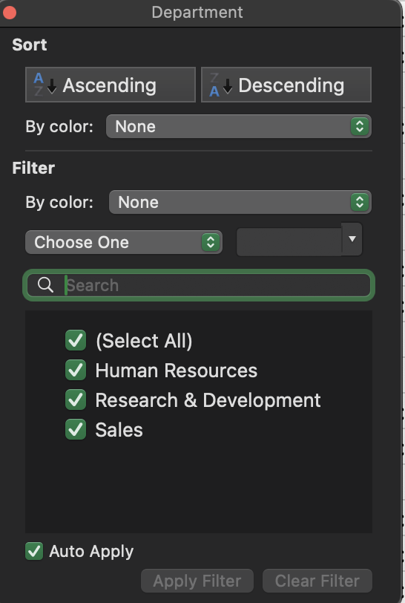
5. Identify and clean any missing or inconsistent data in the "Department" column.
All the data in this column is clean.

Slide 7
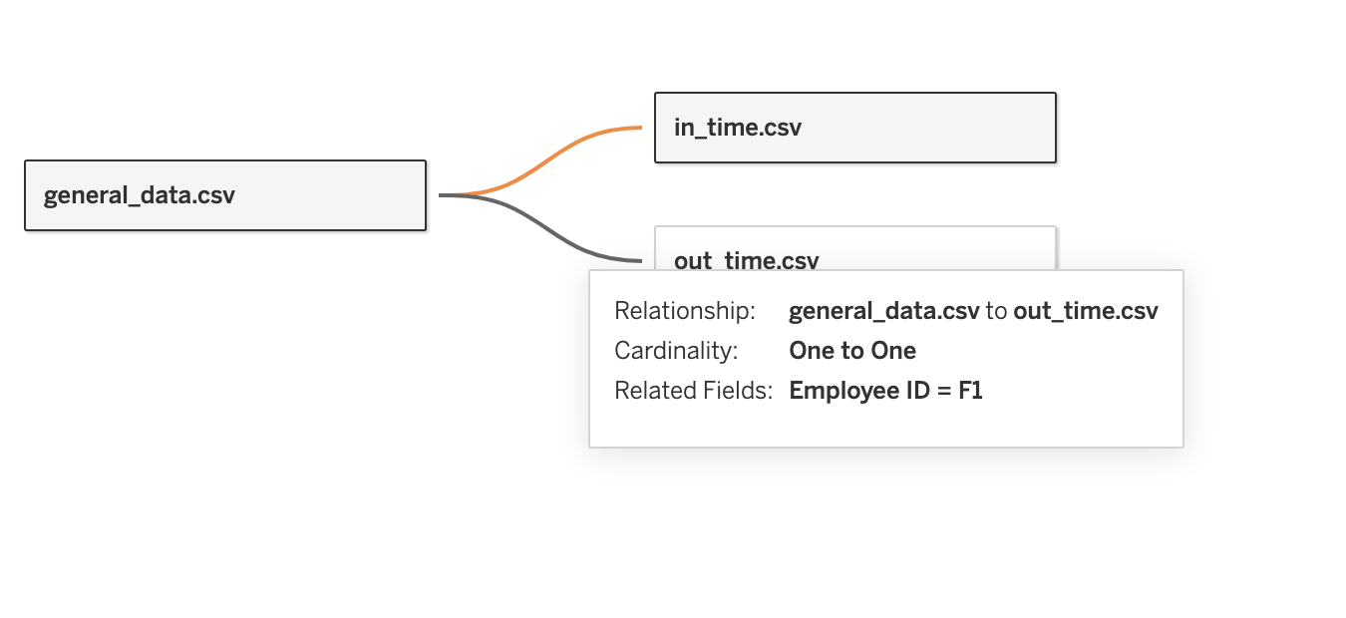
6. In Tableau, establish a relationship between the "EmployeeID" in the employee data and the "EmployeeID" in the time tracking data.

Slide 8
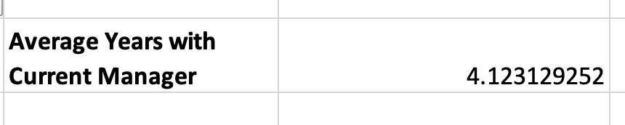
7. create a calculated column that calculates the average years an employee has spent with their current manager.

Slide 9
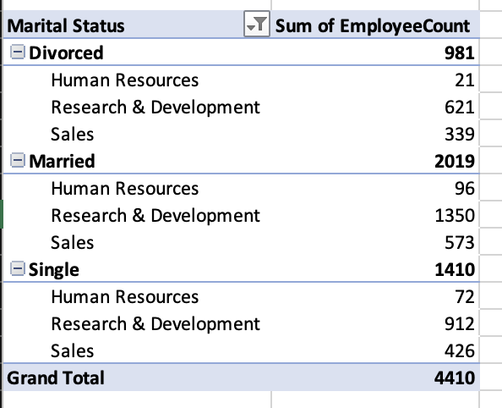
8. Using Excel, create a pivot table that displays the count of employees in each Marital Status category, segmented by Department.

Slide 10
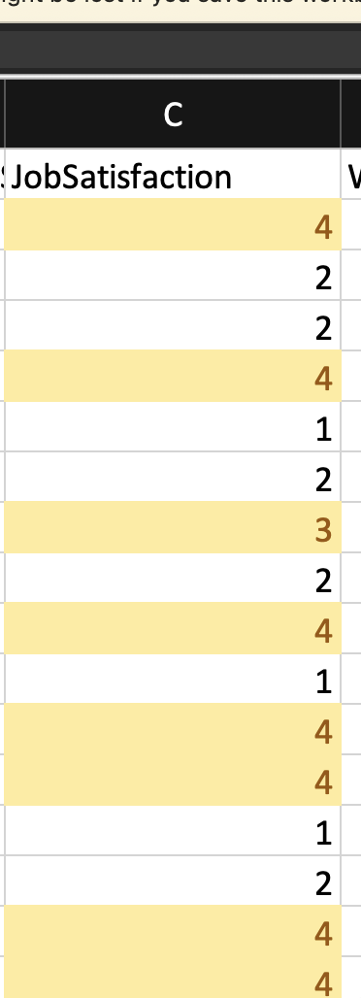
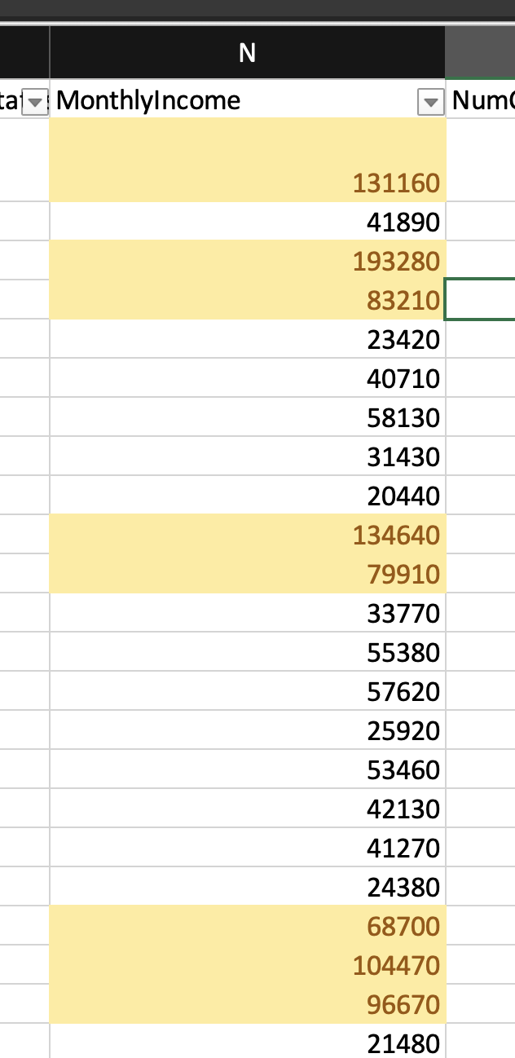
9. Apply conditional formatting to highlight employees with both above-average Monthly Income and above-average Job Satisfaction.

Slide 11
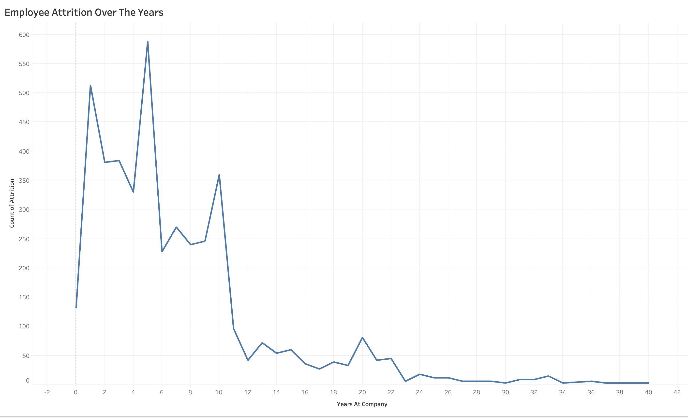
10. In tableau, create a line chart that visualizes the trend of Employee Attrition over the years.

Slide 12
11. Describe how you would create a star schema for this dataset, explaining the benefits of doing so.
﻿﻿﻿Fact Table: Employee Attrition Fact (Employee ID, Year ID, Attrition Count).
﻿﻿﻿Dimensions: a. Employee Dimension: Employee (Employee ID, Employee Name, Department, Marita Status, etc.). b. Time Dimension: Time (Year ID, Year, Quarter, Month, Date-related attributes).
﻿﻿﻿Benefits of Star Schema:
﻿﻿Simplifies structure with clear fact and dimension separation.
﻿﻿Improves query performance through optimized design.
﻿﻿Scales efficiently for large datasets.
﻿﻿Facilitates easy maintenance of dimensions.
﻿﻿Better support for BI tools like Power BI.
﻿﻿Ideal for data warehousing environments.

Slide 13
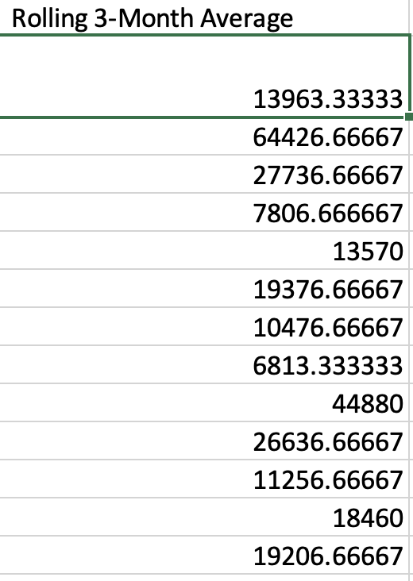
12. calculate the rolling 3-month average of Monthly Income for each employee.

Slide 14
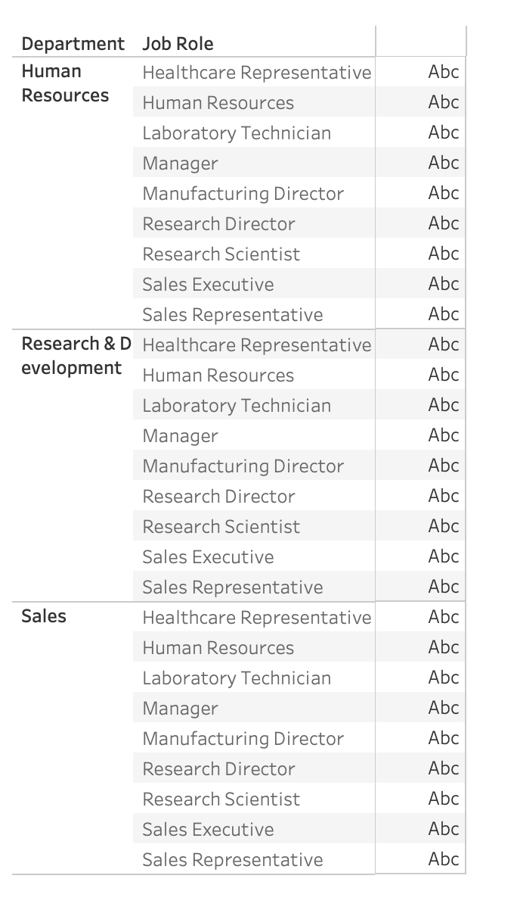
13. Create a hierarchy in Tableau that allows users to drill down from Department to Job Role to further narrow their analysis.

Slide 15
14. How can you set up parameterized queries in Power BI to allow users to filter data based on the Distance from Home column?
 | In Power BI, parameterized queries allow users to dynamically filter data based on
 | predefined parameters. To set up a parameter, create one in the Manage Parameters
 | dialog, assign it a data type, and incorporate it into your queries' filtering logic. By
 | creating a slicer visualization linked to the parameter, users can interactively adjust the
 | filter, enabling dynamic analysis of the dataset. This approach enhances flexibility and
 | empowers users to explore and tailor their insights based on specific criteria, such as
filtering data on the "Distance from Home" column.

Slide 16
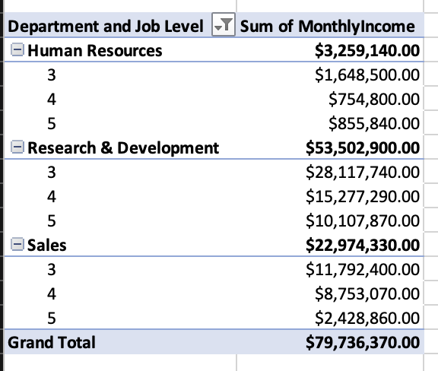
15. In Excel, calculate the total Monthly Income for each Department, considering only the employees with a Job Level greater than or equal to 3.

Slide 17
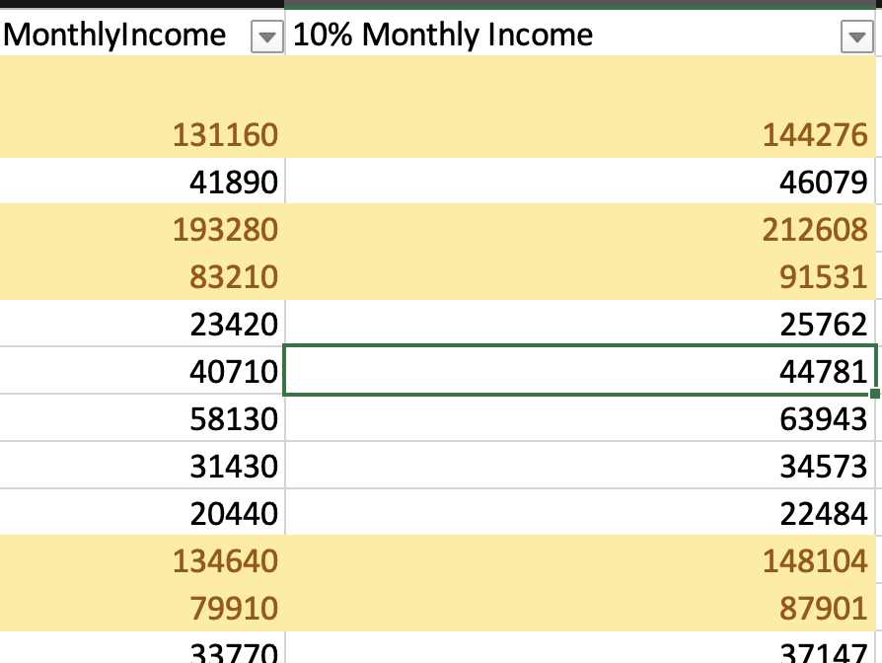
16. Explain how to perform a What-If analysis in Excel to understand the impact of a 10% increase in Percent Salary Hike on Monthly Income.
To perform What If analysis in Excel we can do that from the Data tab and choose what if analysis and choosing scenario manager and adding a scenario with the first monthly income cell as an Example and this is the summary of this.

Slide 18
17. Verify if the data adheres to a predefined schema. What actions would you take if you find inconsistencies?
Yes, the data appears as a star schema
We should identify inconsistencies which they are human errors, system errors, data entry errors, data transfer errors, or data corruption. Some common types are missing values, outliers, duplicates, typos, formatting errors, or inconsistent units or scales.
Choose an appropriate strategy to handle data problems, depending on the nature and extent of the problem and here we find the EmployeelD cell empty in the in_time and out_time tables so we should complete them to make data consistent and ready for analysis, also we found that there isn't any date columns in the dataset so we should create new one to help us analyze data easily.

